Slide 1

Python Programming Bootcamp - Day 1 (Week 2)
Loops – Introduction to While Loop
Atta Muhammad
attapanhyar@quest.edu.pk
+923331971110
Quaid e Awam University of Engineering, Science and Technology

Slide 2
Learning Objectives
Understand what loops are and why they are used in programming.
Learn the syntax and functionality of the while loop in Python.
Explore how to use loops to solve real-world problems.
Apply control flow and while loops together to automate repetitive tasks.

Slide 3
What is a Loop?
Definition: A loop is a control flow structure that repeats a block of code as long as a condition is true.
Why Use Loops?
Automate repetitive tasks.
Process data multiple times.
Reduce redundancy in code.

Slide 4
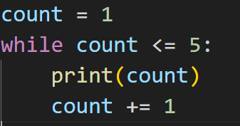
Introduction to While Loop
Syntax
The loop runs if the condition is True. If the condition is False, the loop exits.

Slide 5
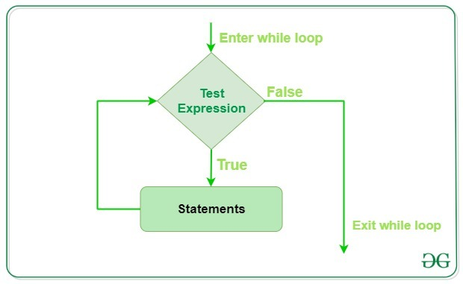
Flowchart of a While Loop

Slide 6
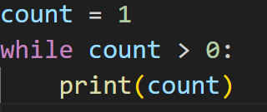
Infinite Loops
What is an Infinite Loop?
Occurs when the condition in the while loop never becomes False.
Danger: Can cause the program to crash or freeze.

Slide 7
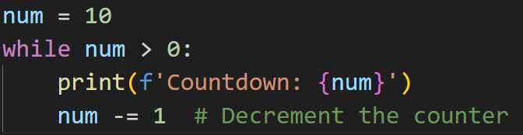
Controlling While Loops with a Counter
Using a Counter: Often, you will increment or decrement a variable to control the number of loop iterations.
Example:

Slide 8
Hands-On Exercise 1
Task: Write a program that prints the numbers from 1 to 10 using a while loop.
Hint: Start with num = 1 and increment it until 10.

Slide 9
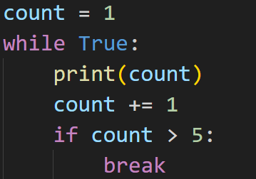
Breaking Out of a Loop
break Statement: Used to exit the loop even if the condition is still true.
Explanation: The loop continues indefinitely until the break statement is encountered.

Slide 10
Hands-On Exercise 2
Task: Write a program that asks the user for numbers and prints them.
Stop the loop when the user enters 0.
Hint: Use a while True: loop and break when the user enters 0.

Slide 11
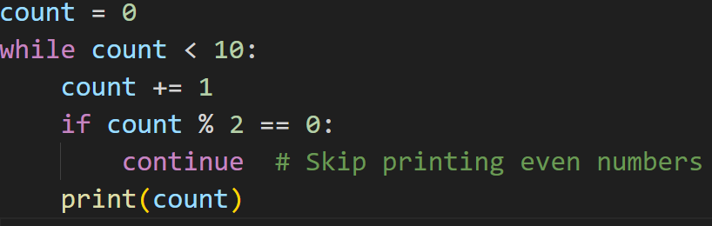
Continue Statement
continue Statement: Skips the rest of the code inside the loop for the current iteration and moves to the next iteration.

Slide 12
Hands-On Exercise 3
Task: Write a program that prints all numbers from 1 to 10, except multiples of 3.
Hint: Use continue to skip numbers divisible by 3.

Slide 13
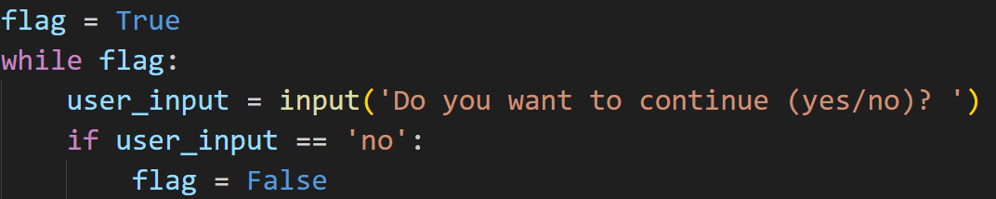
Flags in While Loops
What is a Flag?
A variable used to control whether the loop should continue or stop.
Explanation: The loop continues until the user types "no", at which point the flag is set to False and the loop exits.

Slide 14
Hands-On Group Activity
Scenario: Create a basic ATM system using while loops.
The system should:
Ask the user to input their balance.
Display options to withdraw, deposit, or check balance.
Use a flag to continue until the user chooses to exit.

Slide 15
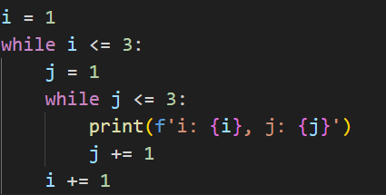
Nested While Loops
Explanation: A while loop can be placed inside another while loop.

Slide 16
Common Pitfalls with While Loops
Infinite Loops: Forgetting to update the loop condition can cause the loop to run indefinitely.
Missing Condition Updates: Ensure counters or flags are updated within the loop.
Off-By-One Errors: Make sure loop conditions are set correctly to avoid unexpected results (e.g., stopping one iteration too early or late).

Slide 17
Hands-On Group Exercise
Scenario: Build a program that simulates a countdown timer starting from a user-specified number.
The timer should count down to 0 and print "Liftoff!" at the end.
Bonus: Add an option for the user to interrupt the countdown early by entering a specific command (use break).

Slide 18
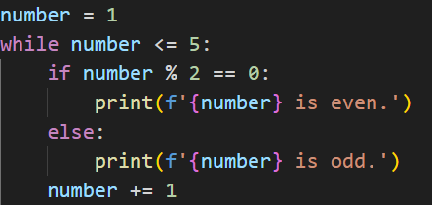
Combining While Loops with If Statements

Slide 19
Hands-On Exercise 4
Task: Write a program that asks the user to guess a secret number between 1 and 10. The program should keep asking until the user guesses correctly.
Hint: Use a while loop and check the condition for whether the guessed number is correct.

Slide 20
Recap and Key Takeaways
Recap:
Loops allow repetition of code blocks.
The while loop continues as long as a condition is True.
Use break to exit the loop and continue to skip the current iteration.
Key Takeaways: Always ensure loop conditions change to avoid infinite loops.
Loops and conditionals can be combined to solve complex problems.

Slide 21
Q&A and Wrap-Up
Open the floor for any questions or clarifications.
Recap the main points of the session.
Briefly mention that Day 2 will cover for loops and how they differ from while loops.

Slide 22
Match the solution 😒

Slide 23
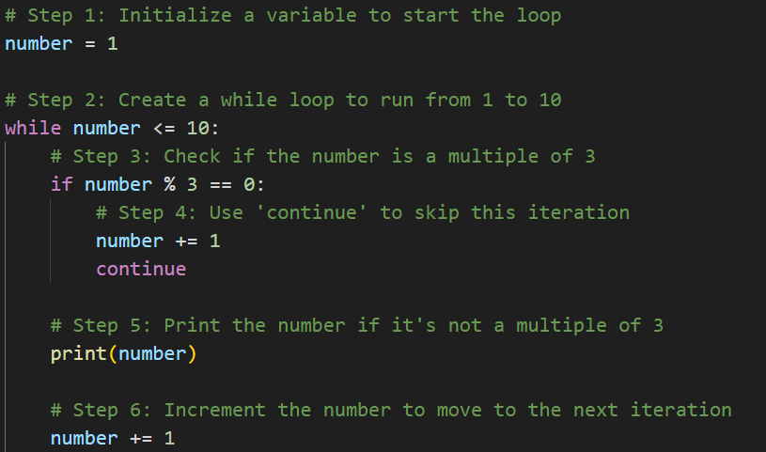

Slide 24
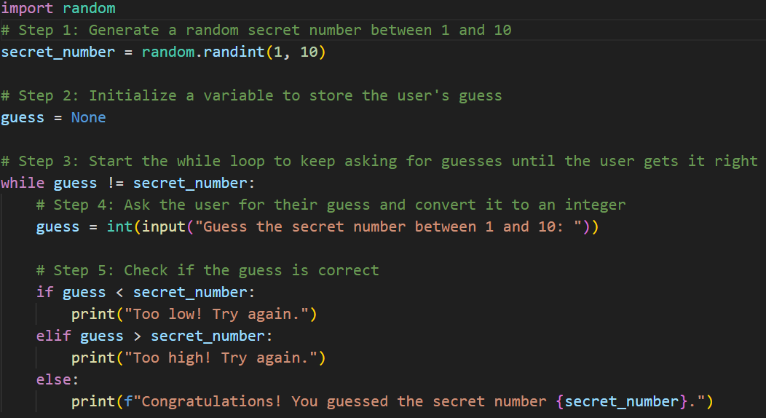

Slide 25
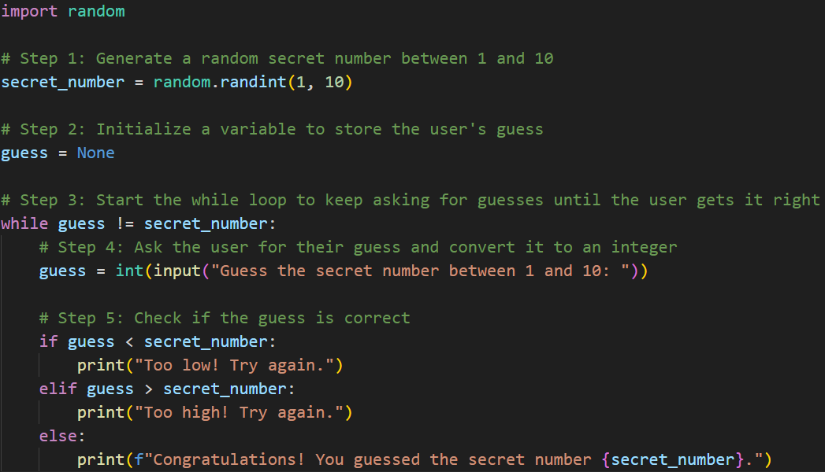

Slide 26
The End

